Slide 1
Introduction to Chrome Extensions
MemoSquare
서나윤ㆍ성예닮

Slide 2
목차
What are extensions?
Chrome extension architecture
Settings for development && Simple practice
Introduction to Chrome API
Advanced practice
MemoSquare architecture

Slide 3
What are extensions?
Chrome extensions are small software programs using in chrome browser
Required technologies - HTML, CSS, JavaScript
Chrome API (sync, async) - https://developer.chrome.com/extensions/api_index

Slide 4
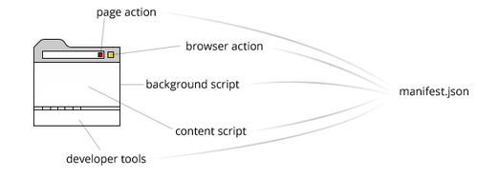
Chrome extension architecture
browser action
- Use for all web pages and all web content (MemoSquare)
page action
- Use for specific web pages or specific web content (No badge, Popup interception)

Slide 5
Chrome extension architecture
manifest.json
- Gives information about the extension - https://developer.chrome.com/extensions/manifest
background script (The most core part!)
- Communication with other components
content script
- Actually working javascript - DOM manipulation

Slide 6
Settings for development
Chrome is required
One of the Sublime Text, Atom, Bracket, Visual Studio Code... (Editor for HTML, CSS, JavaScript)

Slide 7
Simple practice
https://github.com/mybirth0407/Chrome-Extensions-Examples
Download to icon.png, manifest.json

Slide 8
Introduction to Chrome API
Download MemoSquare_Seminar\chrome_extension
Open practice00
API example link: https://developer.chrome.com/extensions/browserAction https://developer.chrome.com/extensions/tabs https://developer.chrome.com/extensions/cookies

Slide 9
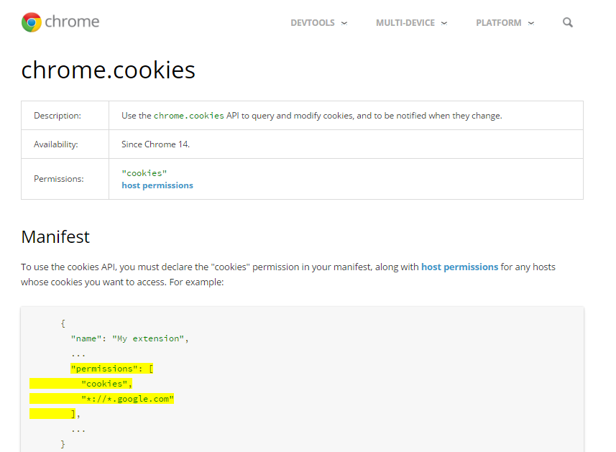
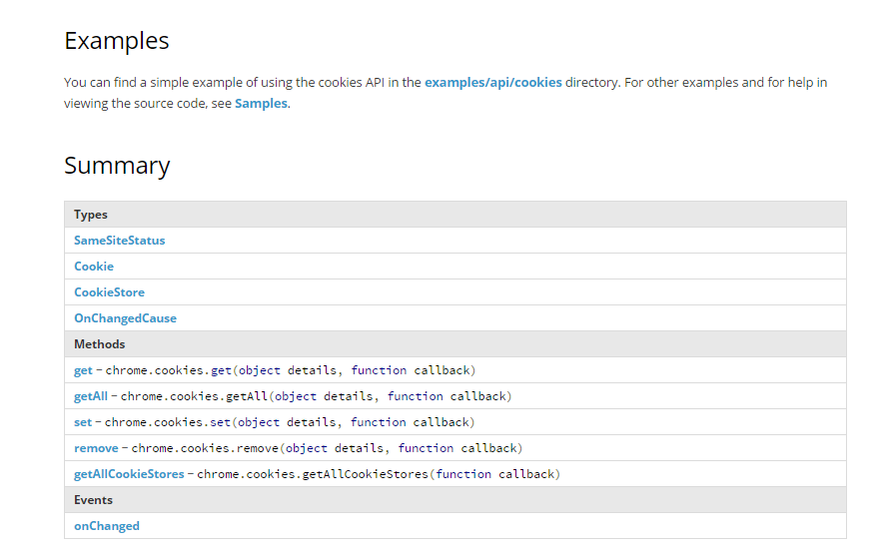
Chrome API

Slide 10
Manifest.json
{
"manifest_version": 2,
"name": "MS Seminar practice",
"version":"0.0",
"description": "MemoSquare Seminar - chrome extenstion 00",
"icons": {
"128": "icon/icon128.png"
},
"browser_action": {
"default_title": "practice 00",
"default_icon": {
"19": "icon/icon24.png"
}
},
"background": {
"scripts": ["background.js"]
},
"permissions": [
"activeTab",
"cookies"
]
}

Slide 11
Background.js
var count = 1;
var colorArr = ["#9cf486", "#c686f4", "#f293b0", "#7bfcfa", "#fcc87b"];
chrome.browserAction.onClicked.addListener(function() {
chrome.tabs.query({currentWindow: true, active: true}, function(tabs) {
chrome.browserAction.setBadgeText(
{text: String(count), tabId: tabs[0].id});
chrome.browserAction.setBadgeBackgroundColor(
{color: colorArr[count % 5], tabId: tabs[0].id});
});
count += 1;
});
chrome.cookies.getAll({url: "http://memo-square.com/"}, function(cookie) {
console.log("\t\t\t\t\t\t\t\tCookies - get=========");
console.log(cookie);
});
chrome.tabs.onActivated.addListener(function(activeInfo) {
console.log("\t\t\t\t\t\t\t\tTabs - onActivated=========");
console.log(activeInfo);
});

Slide 12
Advanced practice
Practice 01 (Message Passing) https://developer.chrome.com/extensions/messaging
Practice 02 (Promatically Injection) https://developer.chrome.com/extensions/content_scripts#pi

Slide 13
MemoSquare Architecture
dafault.js
----------
메인 팝업
default.html
Content scripts
Background.js
editor.js
----------
쓰기 팝업
editor.html
Highlight.js
Medium editor (lib)
Memo-view.js
----------
메모 보기 팝업
Memo-view.html

Slide 14
Background.js
Check cookie of memo-square.com to know whether sign in.
Manage current tab information
Message to each content script (overall features)

Slide 15
Default.js
Inject iframe to DOM of each page
Draw default.html on the iframe
Manage Listeners for default.html elements
Make iframe draggable
Denote Memos of the page

Slide 16
editor.js
Draw editor.html on the iframe
Manage Listeners for editor.html elements
Set location of the cursor on the editable area
Load highlight.js and required libraries
Add user-selected highlight to editable area

Slide 17
Memo-view.js
Draw default.html on the iframe
Manage Listeners for memo-view.html elements

Slide 18
libraries
Medium editor
Materalize
Jquery 3.1.1

Slide 19
Thank you :D

